Slide 1
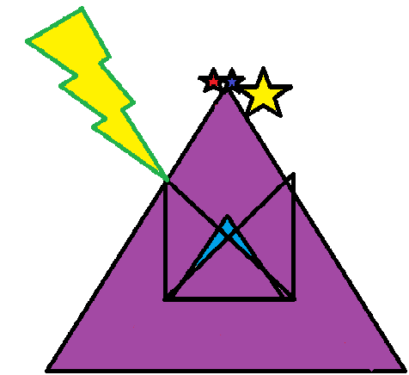
Perpend Stone
Brooks Perpend Stone Petit
Conner Joseph Brewster
Hannah Grace Schroeder

Slide 2
WHAT THE HECK IS A PERPEND STONE?
In the Medieval times, when a two-layer wall was being built, a long stone was occasionally placed inside that stretched the duration of the wall’s layers.
That stone… is the Perpend Stone.

Slide 3
BUT WHY PERPEND STONE?
Because that’s the word the Internet has given us…it also sounds cool.

Slide 4
AGENDA
Unveil our company, Perpend Stone, and our mission to the world at Friendswood High School in Friendswood in Galveston County in Texas in the United States of America in North America in Earth in the Milky Way galaxy in the Local Super cluster in the Universe.
Reveal the company’s sole product: Treasure of the Pyramid. A text-based RPG video game where you are trying to reach the ultimate prize. We decided to aim at middle-aged teenagers.
Discuss the algorithm of the game, almost like a guide (separate document).
Demonstrate the product in working order (outside of this powerpoint).
Next page…

Slide 5
WHY CHOOSE OUR PRODUCT?
Text-based adventure games seem to have fallen out of place in the year 2013. Our product will be the jumpstart to the rising of a new era. Other games lack the unnecessary features that we have spent hours manipulating and coding. The protagonist’s reasoning and actions will keep our consumers entertained until the very end.

